Slide 1

LUCY Security Awareness Software

Slide 2
Outline
What is Lucy Security Awareness software
Why we use Lucy?
Why is security awareness training important?
Lucy security module
General features of Lucy security software

Slide 3
What is Lucy Security Awareness software
Lucy is a cloud-based order processing solution designed to help small to large businesses analyze, capture and create sales orders.
For maximum privacy it can be deployed on premise for an additional fee
It allows organizations to measure and improve the security awareness of employees and test IT defenses

Slide 4
Why we use Lucy?
To minimize the attack fear from company that comes with minimum awareness.
Lucy enables organization to take on the role of an attacker and uncover existing weaknesses in both technical infrastructure and staff knowledge and eliminate them through a comprehensive program.

Slide 5
Why is security awareness training important?
The main benefit of cybersecurity awareness training is protection from attacks on digital systems or a data breach.
Preventing such incidents is critical because a successful cyber-attack can financially cripple an organization and significantly harm its brand reputation.

Slide 6
Lucy Software Modules
Test Employees
Engage Employees
Test Infrastructure
Measure Progress
Train Employees

Slide 7
Test Employees
Would your employees react correctly to hacker attacks?
With a variety of predefined, multilingual attack simulations (phishing, malware, smishing, USB attacks, etc.) you can test whether your employees are really familiar with the dangers of the Internet.
LUCY provides a “safe learning environment” where employees can experience what real attacks would feel like.
LUCY enables you to simulate the full threat landscape that goes beyond just simple phishing emails:

Slide 8
Train Employees
Close knowledge gaps with Lucy’s E-Learning
LUCY offers more than 300 interactive, web-based Training Modules (videos, tests, quizzes, games, etc.) on various security topics that can be provided to employees based on the results of the attack simulations or independently of them.
Employees can manage their own learning content in the LUCY LMS while your IT Administrator tracks their learning progress in real time.
An integrated authoring tool allows you to quickly create new learning content, and Lucy can create custom content for you, as well.

Slide 9
Engage Employees
Turn your employees into human firewalls
The LUCY Mail Plugin for Gmail, Outlook & Office365 actively integrates your employees into the detection of and fight against cyber attacks.
Suspicious e-mails can be reported with just one click and removed from the Inbox. In the LUCY environment the e-mails are then analyzed and evaluated.
Automatic feedback gives the user the risk score.
If the suspect e-mail is a real attack, it can be reported to the responsible provider with the Threat Mitigator.

Slide 10
Test Infrastructure
With the use of phishing simulation you now know that X% of your employees downloaded and executed an unknown file.
But from a technical point of view, what kind of dangerous file types can get to the employee and how big is the risk if such a file is actually executed?

Slide 11
Measure Progress
Monitor attack statistics and eLearning progress in real-time! Track all attack simulation statistics like the number of emails that were opened, how many links were clicked, and how many attacks were successful.
Measure your eLearning progress with training stats and quiz results. You can then easily export your data as CSV, API, PDF, HTML, or DOCX.

Slide 12
General features of Lucy security software
Reminders
Response detection
Full mail communication client
Scheduler Randomization
Performance tools
Multilingual admin interface
Role-based access controls
Campaign templates, and etc.

Slide 13
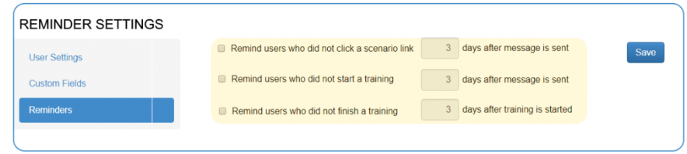
Reminders
Reminders: Reminder templates can be used to automatically resend messages to users who have not clicked on an attack link or a training course after a custom period of time.

Slide 14
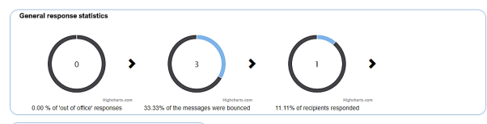
Response detection
The automatic response detection makes it possible to define and analyze automatic e-mail responses (e.g., out of office) as well as mail delivery errors (e.g., user unknown) within the campaign.

Slide 15
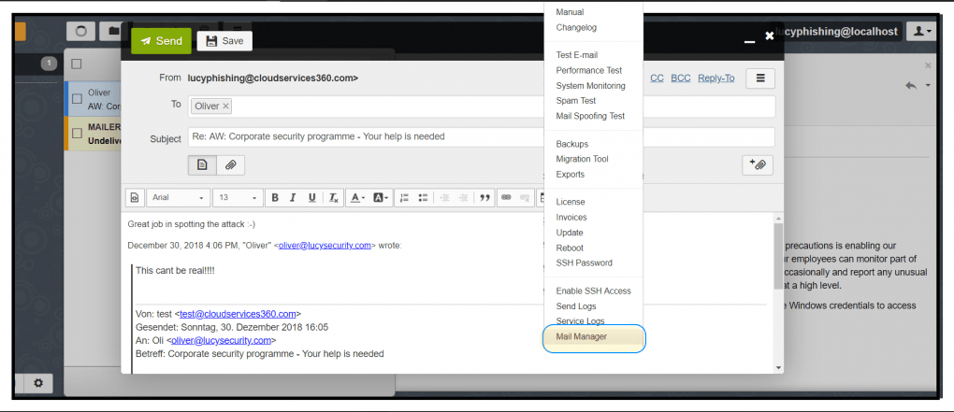
Full mail communication client
A built-in messaging platform allows the LUCY admin to communicate interactively with the recipients inside or outside the LUCY campaigns. All e-mails are archived and can be evaluated.

Slide 16
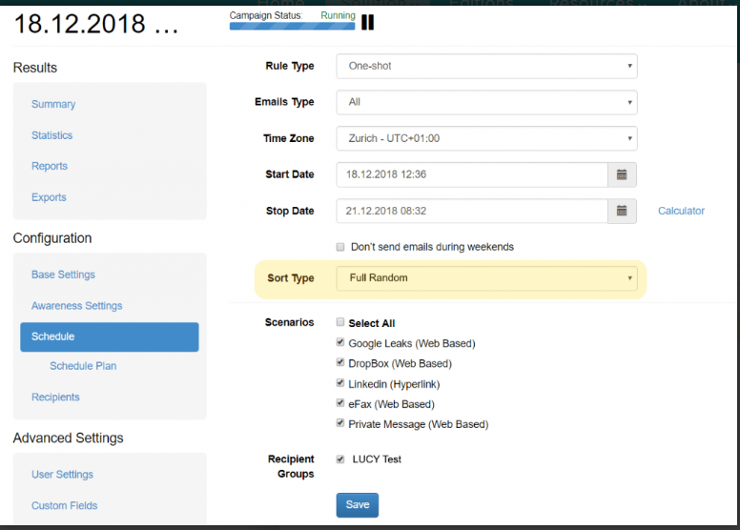
Scheduler Randomization
Raising employee awareness at random is the key factor for effective and sustainable awareness within the organization. Randomly sending many concurrent campaigns is one of the best means of training employees.

Slide 17
Performance tools
LUCY smart routines adapt the server installation to the given resources. Applications Server, DBMS Sizing, Memory and CPU usages are calculated during installation or during operations.
You can scale a single, cloud-based LUCY installation for 400,000+ users.

Slide 18
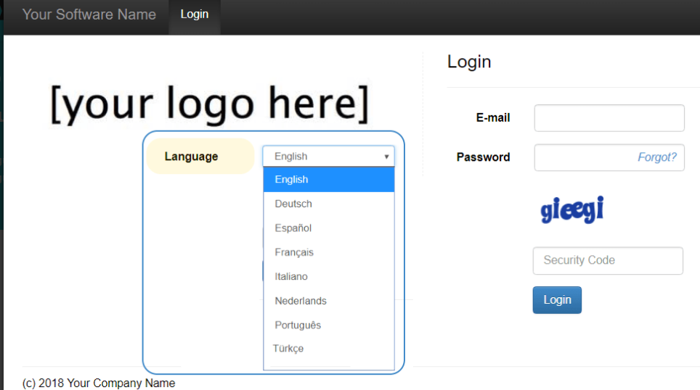
Multilingual admin interface
The LUCY admin interface is available in different languages and can be translated into other languages on request.

Slide 19
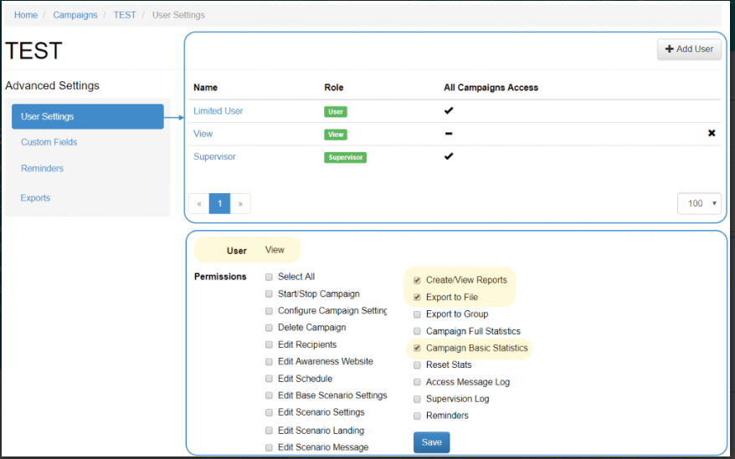
Role-based access controls
LUCY offers a role-based access control (RBAC) that restricts system access to authorized users only. The permissions to perform certain operations are assigned to specific roles within the user settings.
Members or staff (or other system users) are assigned particular roles through which to acquire the necessary computer permissions to perform particular LUCY functions.

Slide 20
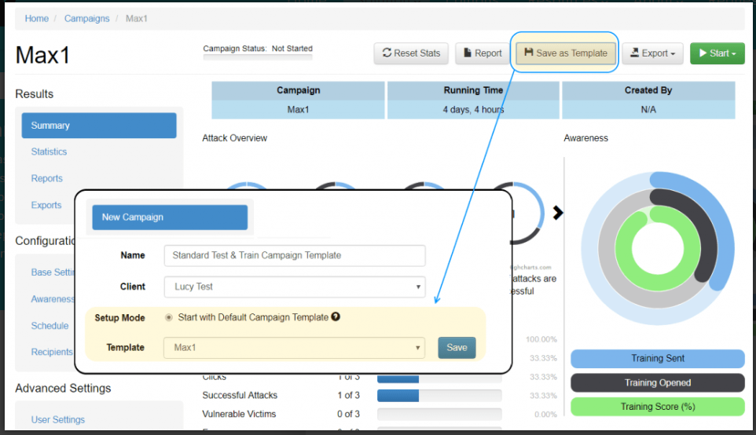
Campaign templates
Incase you want to reuse similar campaigns, you can save a complete campaign with attack templates and eLearning content as a campaign template. This feature allows you to evade having to repeat similar configurations over and over again.

Slide 21
THANK YOU

